Slide 1
Windows Containers, Hyper-V and OpenStack

Slide 2
Who are we?

Slide 3

Ben Armstrong
I am Principle Program Manager at Microsoft.
I have been working on virtualization for over a decade, and has worked on products such as Virtual PC, Virtual Server and Hyper-V.
Right now I am focused on building the next release of Hyper-V and Windows Server containers.
@VirtualPCGuy

Slide 4

Alessandro Pilotti
CEO at Cloudbase Solutions
Project lead for all the Windows and Hyper-V integration in OpenStack
Hyper-V MVP
@cloudbaseit

Slide 5
Agenda
Windows Containers
Hyper-V
OpenStack Integration
Docker Integration
Rude Questions
Friendly Questions

Slide 6
Windows Containers

Slide 7
Containers A new approach to build, ship, deploy, and instantiate applications
Applications traditionally built and deployed onto physical systems with 1:1 relationship
New applications often required new physical systems for isolation of resources
Package and run apps within
Containers
Physical
Physical/Virtual
Higher consolidation ratios and better utilization
Faster app deployment than in a traditional, physical environment
Apps deployed into VMs with high compatibility success
Apps benefited from key VM features i.e. Live migration, HA
Key Benefits
Further accelerate of app deployment
Reduce effort to deploy apps
Streamline development and testing
Lower costs associated with app deployment
Increase server consolidation
Virtual

Slide 8
Windows Server Containers Anatomy and key capabilities
Container A
Container B
Container C
Spotlight capabilities
Web tier
App tier
DB tier
Build: Developers will use familiar development tools, such as Visual Studio, to write apps to run within containers.
By building modular apps leveraging containers, modules can scale independently, and be updated on independent cadences.
Run: Container capabilities built into Windows Server
Manage: Deploy and manage containers using PowerShell, or using Docker client.
Resources: Define CPU and memory resources per container along with storage and network throughput.
Network: Provide NAT or DHCP/static IP for network connectivity.
LOB app (+Binaries)
LOB app (+Binaries)
LOB app (+Binaries)
Libraries (Shared across containers)
Libraries
Windows User Mode
Windows Kernel with Container Support
Physical/Virtual Server

Slide 9









Write once deploy anywhere Modern app development with flexible isolation
CONTAINER RUN-TIMES
Hyper-V Container
Docker
Application
Framework
Application
framework
PowerShell
Others
Windows Server Container
Windows container images
Container management

Slide 10
Demo
Windows Containers

Slide 11
Hyper-V

Slide 12
Hyper-V History
Windows Server 2008 R2
System Center 2007 R3
Windows Server 2012
System Center 2012
Windows Server 2012 R2
System Center 2012 R2
Microsoft Azure
Introduced virtualization platform/ management
Industry-leading scale and performance
Azure as design point

Slide 13
A leader in Gartner magic quadrants
x86 Server Virtualization¹
Microsoft only leader in all four magic quadrants
Public Cloud Storage Services²
Cloud Infrastructure as a Service³
Enterprise Application Platform as a Service⁴
[1] Gartner “x86 Server Virtualization Infrastructure,” by Thomas J. Bittman, Philip Dawson, July 2 2014; [2] Gartner “Public Cloud Storage Services,” by Gene Ruth, Arun Chandrasekaran, July 9, 2014; [3] Gartner “Magic Quadrant for Cloud Infrastructure as a Service,” by Lydia Leong, Douglas Toombs, Bob Gill, Gregor Petri, Tiny Haynes, May 28, 2014; [4] Gartner “Enterprise Application Platform as a Service,” by Yefim V. Natis, Massimo Pezzini, Mark Driver, David Mitchell Smith, Kimihiko Iijima, Ross Altman, Jan, 7 2014.
Gartner does not endorse any vendor, product or service depicted in its research publications, and does not advise technology users to select only those vendors with the highest ratings or other designation. Gartner research publications consist of the opinions of Gartner's research organization and should not be construed as statements of fact. Gartner disclaims all warranties, expressed or implied, with respect to this research, including any warranties of merchantability or fitness for a particular purpose.

Slide 14
OpenStack Integration

Slide 15
Architecture Concept
Portal
Network
Compute
Image
Blob
Block
Identity

Slide 16
Hyper-V Nova Compute
Mature driver, available since Folsom
http://cloudbase.it/openstack-compute-installer
Rich feature set, Nova group B hypervisor
Notable upcoming features:
vNIC hot plug
Compute, networking and storage QoS
Failover clustering (hello pets!)
vNuma
vTPM (shielded VMs)
UEFI SecureBoot (Windows and Linux)
Fibre channel volumes

Slide 17
Neutron
Hyper-V plugin is part of Neutron since Jan 2013
Supported network types:
VLAN
Flat
Local
NVGRE
Plugin / agent model
ML2 plugin runs in neutron-server (controller)
Agent runs on each Hyper-V compute node

Slide 18
Neutron
Neutron ML2 agent works side by side with Open vSwitch!!
You can use the OVS agent with Hyper-V agents (or vice versa)
Limited to compatible L2 protocols: Flat / VLAN
You can use the L3 and DHCP agents with the Hyper-V plugin
Using the OVS L2 agent on the other networking nodes
Great for interoperability (e.g. KVM + Hyper-V)

Slide 19
Open vSwitch on Hyper-V
OVS has been fully ported to Hyper-V!
community effort between Cloudbase Solutions and VMWare
2012 R2 and 2016
Code available upstream: Apache 2
Full CLI and OVSDB compatibility with Linux
Available starting with OVS 2.4
http://www.cloudbase.it/open-vswitch-on-hyper-v/
Neutron OVS ML2 agent already ported to Windows
Alternative to the Hyper-V native SDN stack

Slide 20
Cinder volume on Windows iSCSI / SMB3
Cinder includes drivers for Windows Server 2012 / 2012 R2 / 2016
iSCSI
SMB3 (recommended for Hyper-V)
Installer available for Windows
Supports Storage Spaces and Storage Spaces Direct (Calabria)
http://www.cloudbase.it/cinder-volume-on-windows-storage-server-2012/
Deployment easily integrated with Puppet, Juju, Chef, SaltStack, etc

Slide 21
Keystone & Active Directory
Keystone fully supports partial and full integration with Active Directory
AD is the 3rd most common backing store for Keystone deployments today

Slide 22
More Windows OpenStack support
Ceilometer
Compute inspector
Manila
Windows file server
Coming in Liberty

Slide 23
Windows As A Guest - Windows Cloud-Init
Cloudbase-init (aka Windows Cloud-Init)
Similar to the Linux cloud-init
License: Apache 2
Upcoming Cloud-Init v2
Full rewrite, merging Cloud-Init and Cloudbase-Init efforts and teams
Supported data sources:
OpenStack HTTP
ConfigDrive
EC2
And more: CloudStack, OpenNebula, Ubuntu MAAS

Slide 24
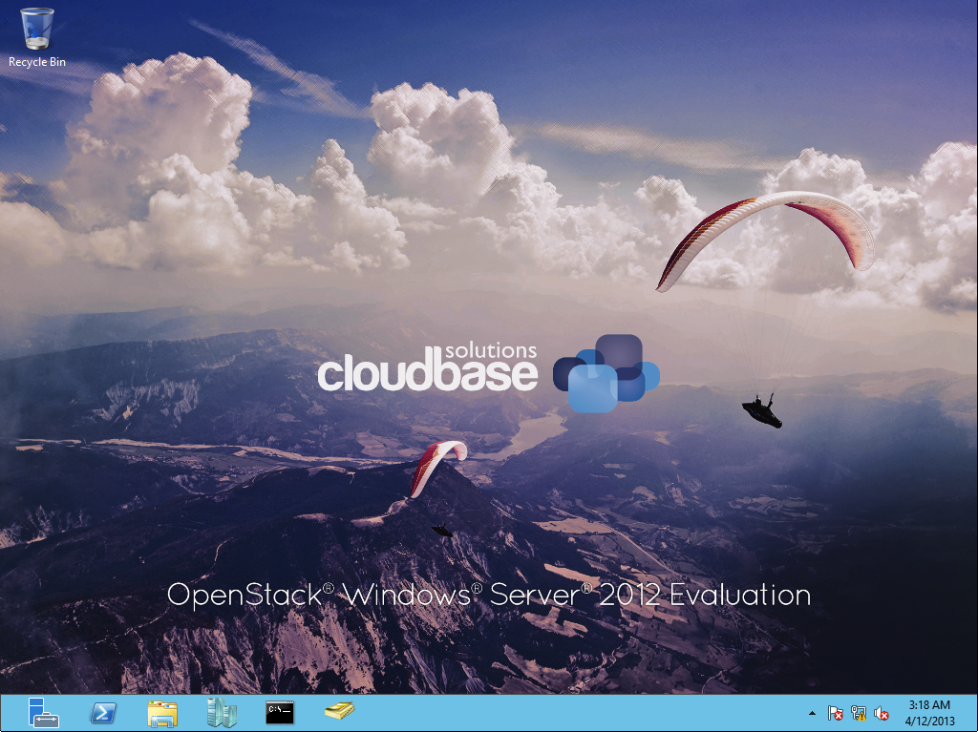
OpenStack Windows Server

Slide 25
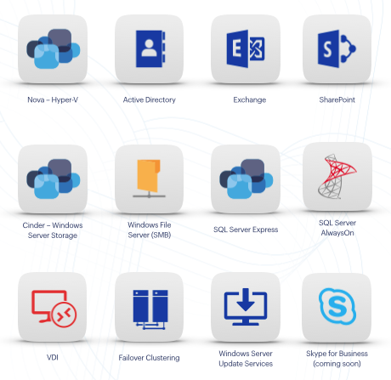
Orchestration
Heat templates
Active Directory
SQL Server
SharePoint
Exchange…
Juju charms
http://cloudbase.it/juju

Slide 26
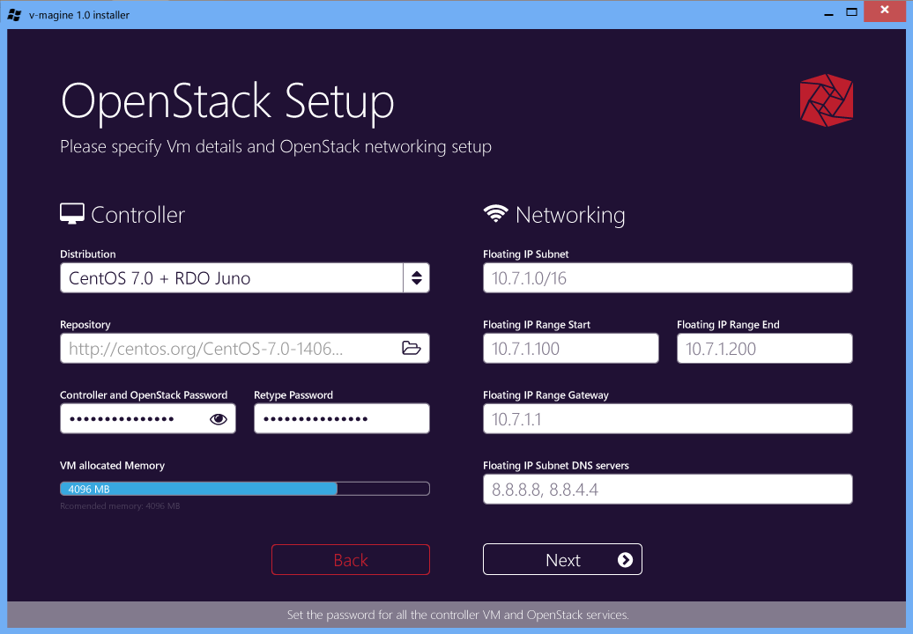
v-magine
Full OpenStack PoC made easy!
Runs on Windows and Hyper-V
Hyper-V 2012 R2 and 2016 TP3
Windows 8.1 and 10
Even on a Surface3!
Just download and run:
http://cloudbase.it/v-magine/

Slide 27
Demo
OpenStack Integration Demo

Slide 28
Docker Integration

Slide 29


Docker integration Joint strategic investments to drive containers forward
Docker: An open source engine that automates the deployment of any application as a portable, self-sufficient container that can run almost anywhere.
Partnership: Enable the Docker client to manage multi-container applications using both Linux and Windows Server containers, regardless of the hosting environment or cloud provider.
Customer
Datacenter
Dockerized app
Windows Server
Container
Linux Container
Run anywhere
Microsoft
Azure
Service
Provider
Docker
}
Investments in upcoming Windows Server release
Open source development of the Docker Engine for Windows Server
Azure support for the Docker Swarm APIs
Federation of Docker Hub images into the Azure Gallery and Portal
Strategic investments

Slide 30
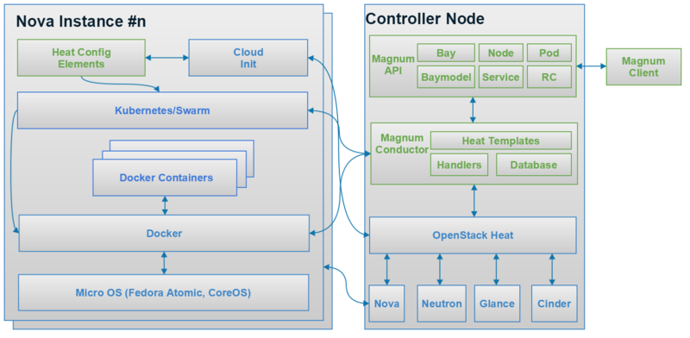
Project Magnum

Slide 31
Demo
Docker Integration Demo

Slide 32
Rude Questions

Slide 33
But you have your own Cloud Stack!
Yes – and we would like you to use it ☺
However – we are happy to be part of any cloud computing platform that you build

Slide 34
But you won’t support this!
Yes – we will*
We support Windows + Enterprise Server applications on any virtualization platform that is part of the SVVP (http://www.windowsservercatalog.com/svvp.aspx)
We do not make support statements about any management software – we don’t need to. That is the point of an ecosystem ☺

Slide 35
Friendly Questions?

